Slide 1

Madhumita Patro
Data Analyst Project1- Coca Cola Stock

Slide 2
Step 1: Problem Definition
● Objective: Predict Coca-Cola's stock prices (e.g., Close price) and analyze
trends.
● Data: Historical data with Date, Open, High, Low, Close, Volume,
Dividends, Stock Splits.
● Deliverables:
1. Insights from the data (visualizations and statistics).
2. An ML model to predict stock prices.
3. A live-updating system for predictions.

Slide 3
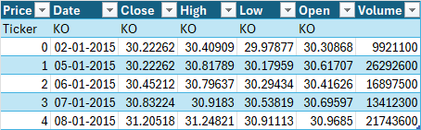
Step 2: Data Collection
Use Yahoo Finance API for historical data. We'll fetch data from 2015 to the present.
Table obtained as result of running Data Collection:

Slide 4
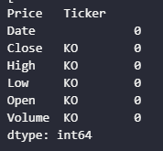
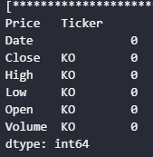
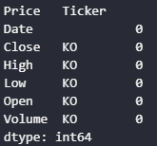
Step 3: Data Cleaning
3.1 Handle Missing Values
Check for missing values and decide on imputation or deletion.
Fill missing numerical values with the column mean
Confirm no missing values remain

Slide 5
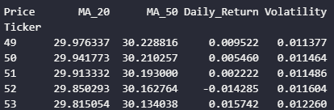
Step 4: Feature Engineering
Add Moving Averages: 20-day and 50-day for trend detection.
Add Daily Returns: Helps capture volatility.
Add Volatility: Standard deviation over a rolling window.

Slide 6
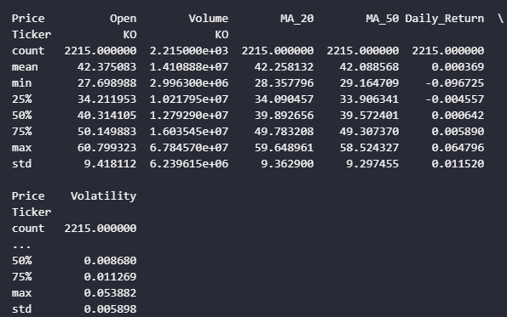
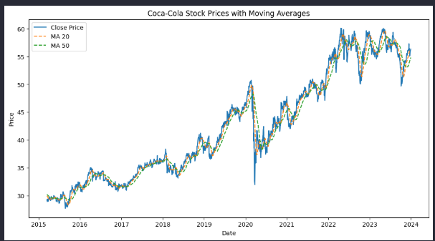
Step 5: Exploratory Data Analysis (EDA)
Use descriptive statistics to summarize the data.
Data Visualization

Slide 7
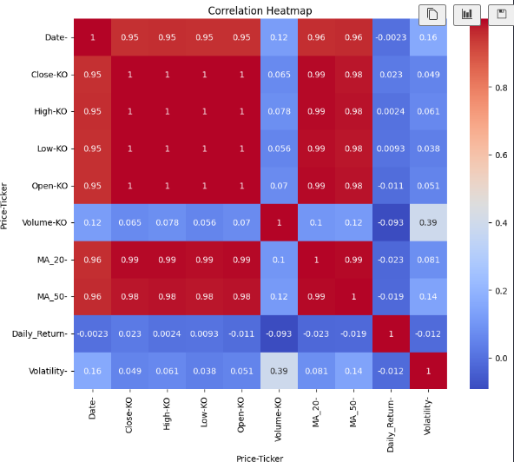
Heat Map
Correlation heatmap

Slide 8
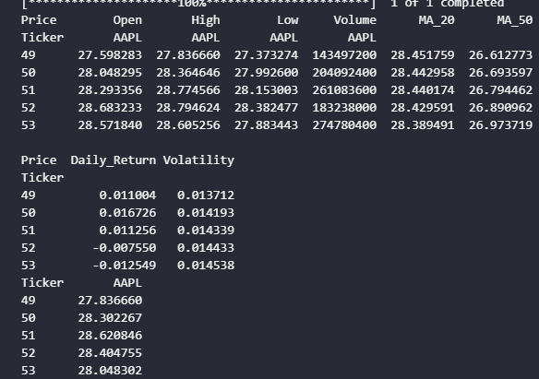
Step 6: Data Splitting
Split the data into training and testing sets for model training.

Slide 9

Step 7: Model Training
7.1 Use Random Forest for Initial Predictions
A good baseline model for tabular data is Random Forest.
Integrate a system to fetch live data and make predictions.
Step 8: Live Prediction System

Slide 10
Step 9: Deploy the System
Deploy using Streamlit or Flask for a web-based dashboard. Example with Streamlit:
Contd. In next slide

Slide 11
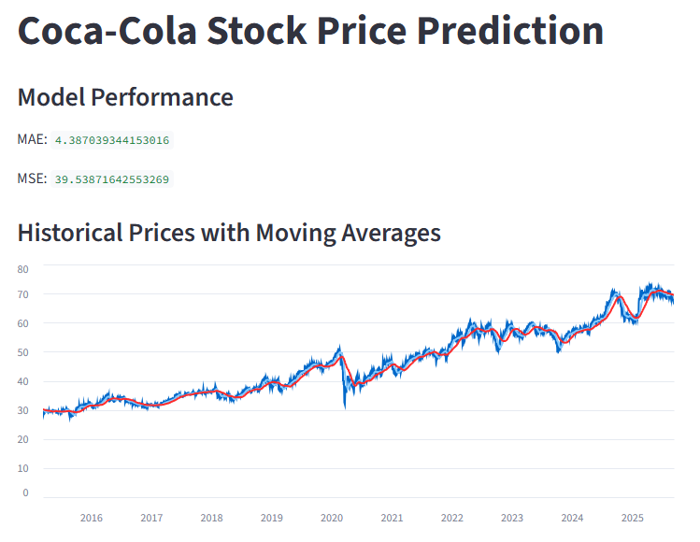

Website Opens

Slide 12
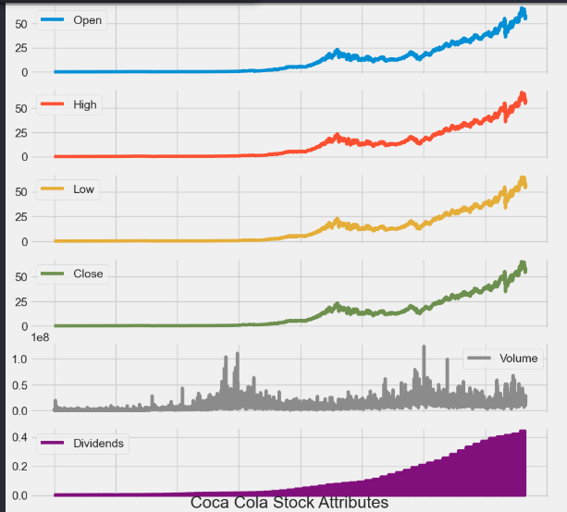
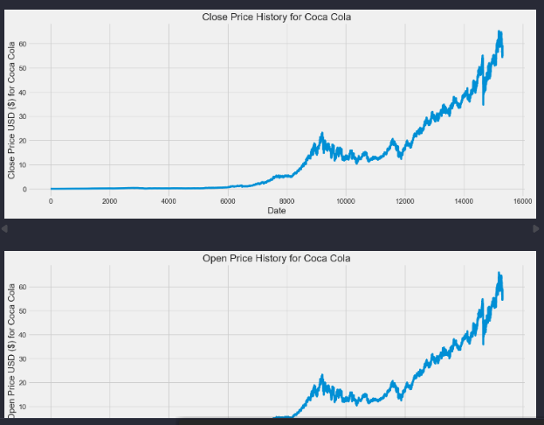
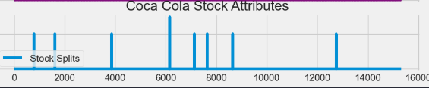
Stock Analysis of Coca Cola Stock

Slide 13
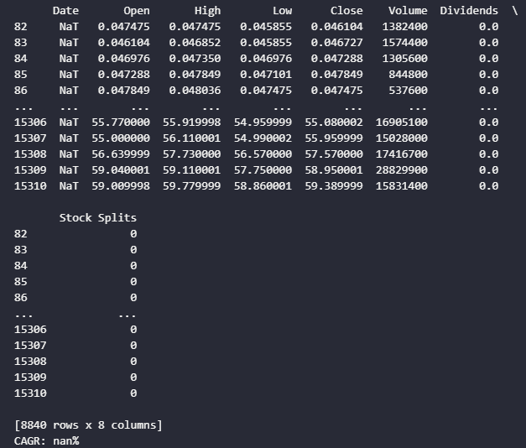
Basic Rolling Averages

Slide 14
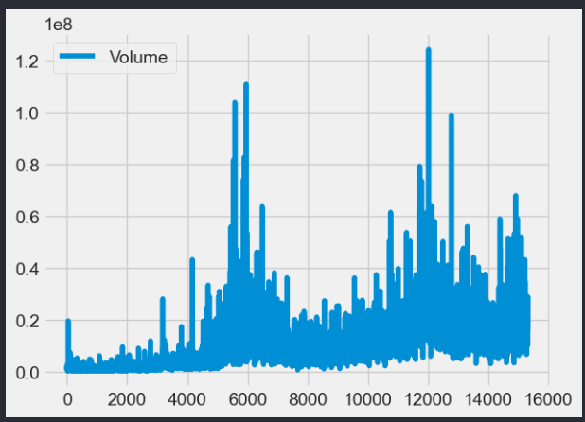
Basic Rolling Averages

Slide 15
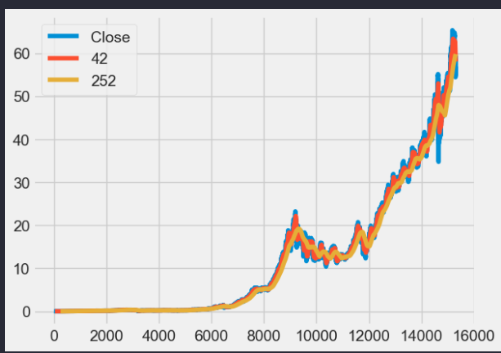
Short moving window rolling mean, Long moving window rolling mean, Plot the adjusted closing price, the short and long windows of rolling means

Slide 16
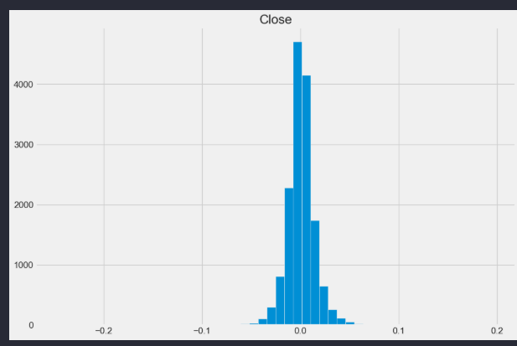
Calculate the daily percentage change for `daily_close_px`, Plot the distributions, Show the resulting plot

Slide 17
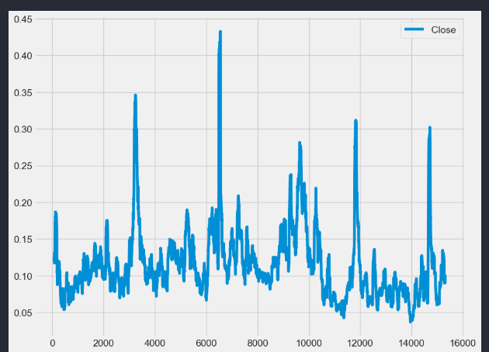
Define the minimum of periods to consider, Calculate the volatility, Plot the volatility, Show the plot

Slide 18
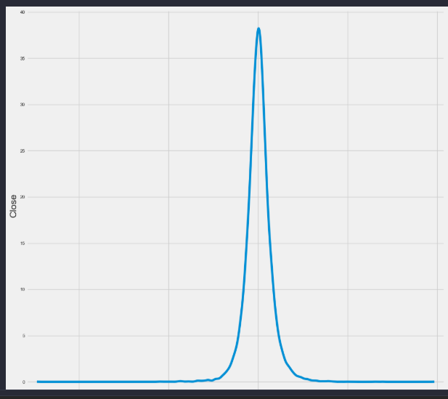
Plot a scatter matrix with the `daily_pct_change` data, Show the plot

Slide 19
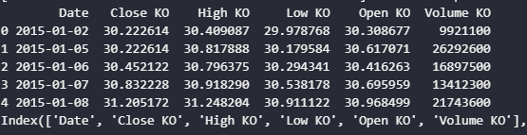
Basic MACD

Slide 20
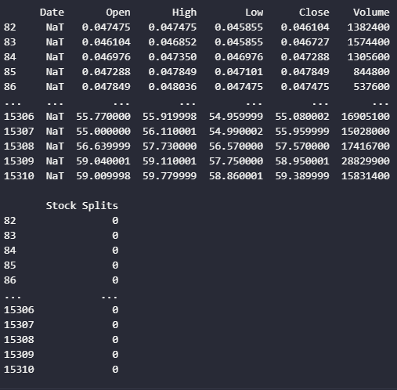
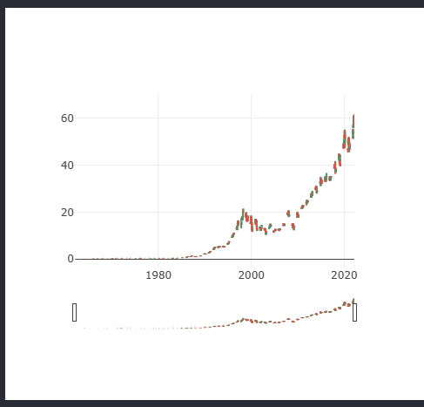
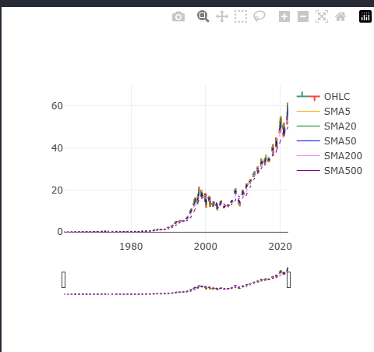
Basic SMA

Slide 21
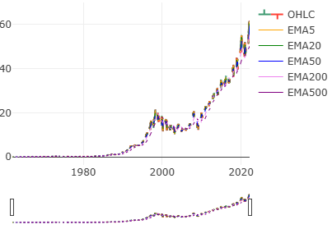
Basic EMA

Slide 22
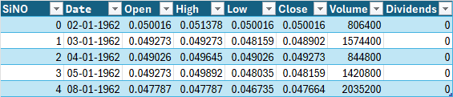
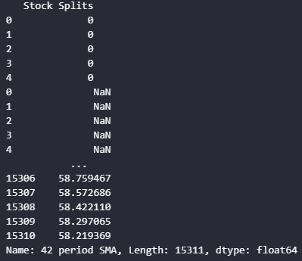
6 FINTA Tech Analysis Ratios

Slide 23
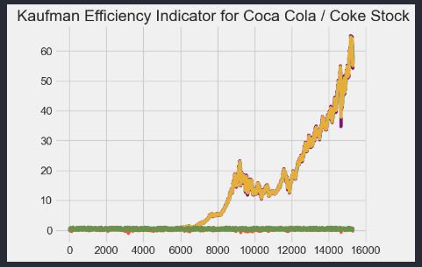
Kauffman Efficiency Indicator for Coca Cola Stock

